Slide 1
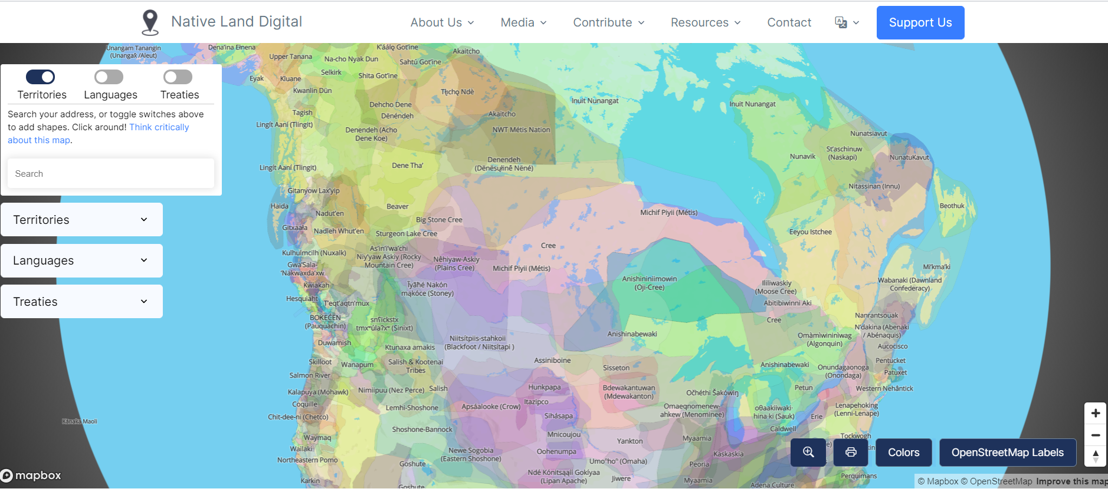
https://native-land.ca/

